Slide 1

Shri Vishnu Engineering College For Women (Autonomous)
Department of CSE
Academic Year :: 2024-25 :: II Semester
III B.Tech :: Mini Project Reviews
Review -1 : 06.01.25
Batch Number: B - 13
Project Title:
AirHealth: A Machine Learning-Based Web Application for Health Impact Classification and Prediction
SNO | Regd no. | Student Name
1 | 22B01A0582 | Kathulla Yamini
2 | 22B01A05B0 | Manchem Shunmadhuri Suryaja
3 | 22B01A05C9 | Naramsetti Asritha
4 | 23B05A0507 | Katha Venkata Chaturya
Project Guide: Mr.Y.Ramu

Slide 2
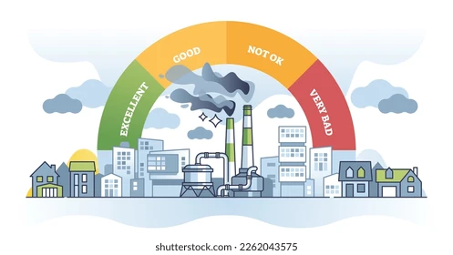
CONTENTS
Abstract
Problem Statement
Project Overview
Existing system
Proposed system
Project Objectives
Data Set & Insights
Implementation Plan
Expected Results
References

Slide 3
ABSTRACT
Air pollution poses a major risk to human health, contributing to millions of deaths globally each year.
"AirHealth" is a machine learning-based web application designed to classify health impacts by severity and predict the likelihood of health effects using air quality indices and pollutant data.
The application delivers accurate health impact assessments to empower informed decision-making for policymakers, healthcare professionals, and the public.

Slide 4
PROBLEM STATEMENT
Air pollution significantly impacts human health, causing millions of illnesses and deaths annually. There is a need for an accurate, accessible tool to predict and classify health risks based on air quality and pollutant levels, enabling informed decisions for better health outcomes.

Slide 5
PROBLEM OVERVIEW
Air pollution is a leading cause of respiratory and cardiovascular diseases, affecting millions worldwide.
Accurate assessment of health impacts from pollutant levels is crucial for mitigating risks.
Current systems lack real-time, reliable tools for predicting and categorizing health effects.
Develop a machine learning-based web application to bridge this gap and provide actionable insights.

Slide 6
EXISTING SYSTEM
Current systems rely on general studies and manual assessments for health risk evaluation.
Health impact assessments are often not real-time or personalized.
Existing methods may lack precision in correlating air quality data with health outcomes.
No integrated, user-friendly platform exists for predicting and categorizing health risks effectively.

Slide 7
PROPOSED SYSTEM
Develop a user-friendly web platform for health impact prediction and classification.
Use classification and regression algorithms to analyze air quality and pollutant data.
Provide accurate, real-time health risk assessments based on environmental factors.
Empower policymakers, healthcare professionals, and the public with actionable health insights.

Slide 8
Project Objectives
Develop a machine learning model to predict the likelihood of health issues (e.g., respiratory and cardiovascular diseases) based on real-time air quality data, including AQI and pollutant concentrations
Build a classification model to categorize the severity of health impacts (low, moderate, high) based on the same environmental and pollutant data.
Integrate the models into a web application that provides real-time predictions and severity classifications, allowing users to understand their health risks based on current air quality data

Slide 9
DATA SET & INSIGHTS
The dataset includes air quality indices (AQI), pollutant levels (PM2.5, PM10, NO2, SO2, O3), temperature, humidity, wind speed, and health-related outcomes (respiratory/cardiovascular cases, hospital admissions).
The health impact score (continuous) and health impact class (categorical) represent the severity of health effects.
The dataset reveals correlations between pollutant concentrations, weather conditions, and health outcomes.
Significant patterns indicate how air quality directly affects public health, with higher pollutant levels leading to increased health risks.

Slide 10
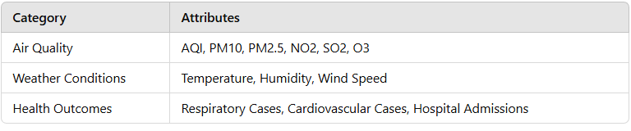
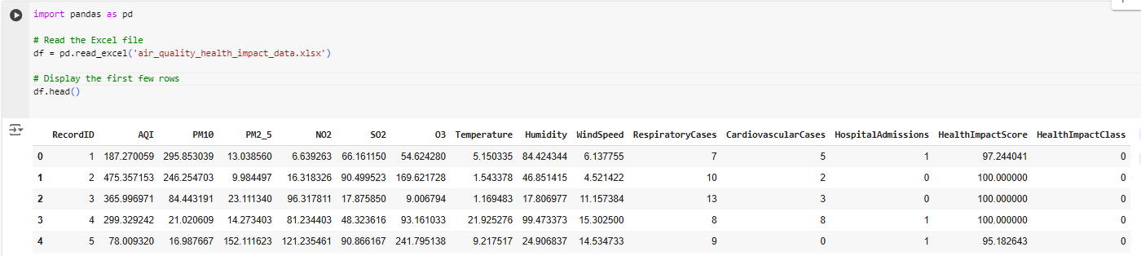
Dataset & Insights
Attributes Table
Sample 5 rows of our dataset

Slide 11
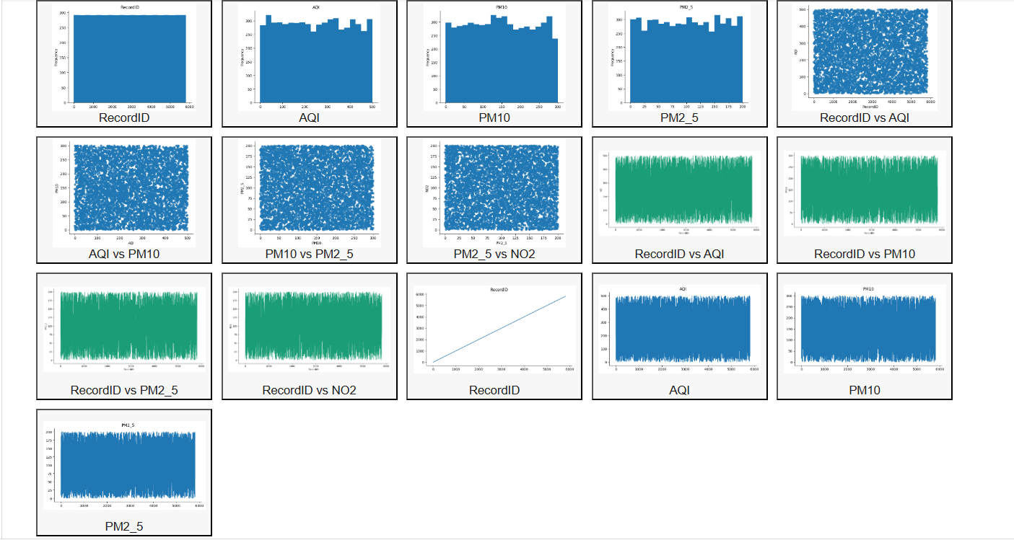
Some Plots from Dataset using Pandas

Slide 12
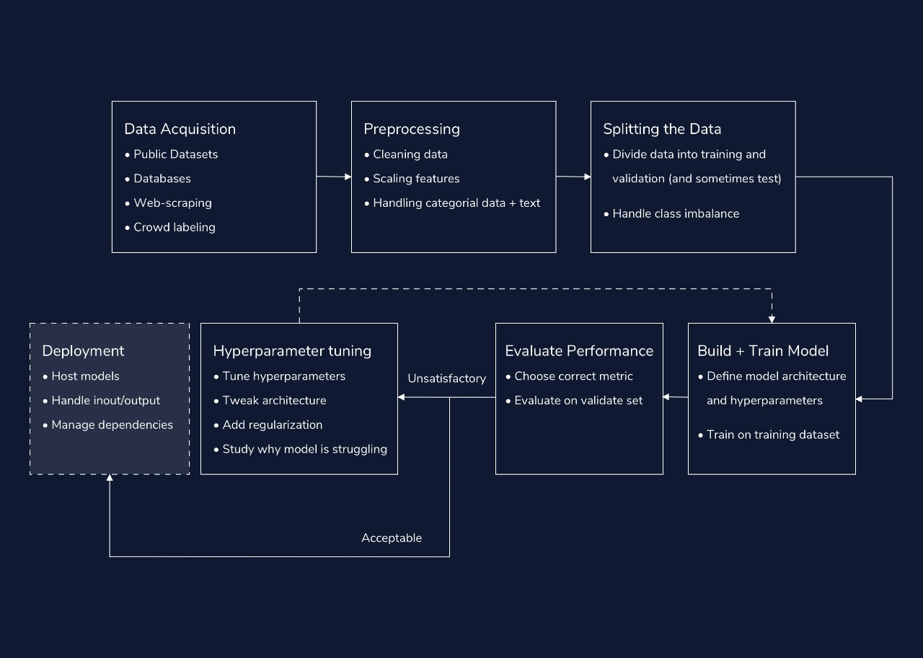
Methodology:

Slide 13
Implementation Plan
Health Impact Prediction
Linear Regression: Predicts the target by fitting a straight line based on input features.
Decision Trees: Splits data into smaller subsets using decision rules to predict the target.
Random Forest: Combines multiple decision trees to improve prediction accuracy.
Support Vector Machines : Uses hyperplanes in a high-dimensional space for regression tasks.
Health Impact Classification
Decision Trees: Classifies data by following decision rules based on feature thresholds.
Random Forest: Uses an ensemble of decision trees to improve classification reliability.
Support Vector Machines : Separates classes by maximizing the margin between decision boundaries.
K-Nearest Neighbors: Classifies data by majority voting from its nearest neighbors.

Slide 14
Web Integration
Flask: A lightweight framework for building APIs and web applications, ideal for serving machine learning models.
NumPy: A library for numerical computations, supporting operations on large, multi-dimensional arrays and matrices.
Pandas: A powerful library for data manipulation and analysis, providing data structures like DataFrames for handling tabular data.
scikit-learn: A machine learning library for training, evaluating, and deploying models with ease.
pickle: A Python module to serialize (save) and deserialize (load) machine learning models efficiently

Slide 15
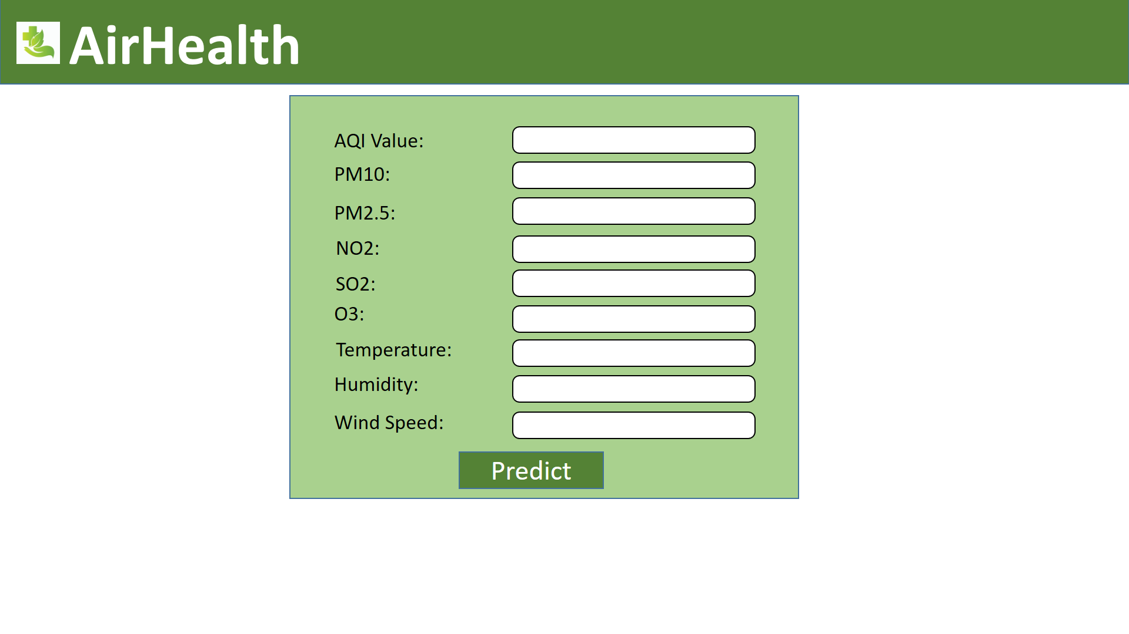
Excepted Results

Slide 16
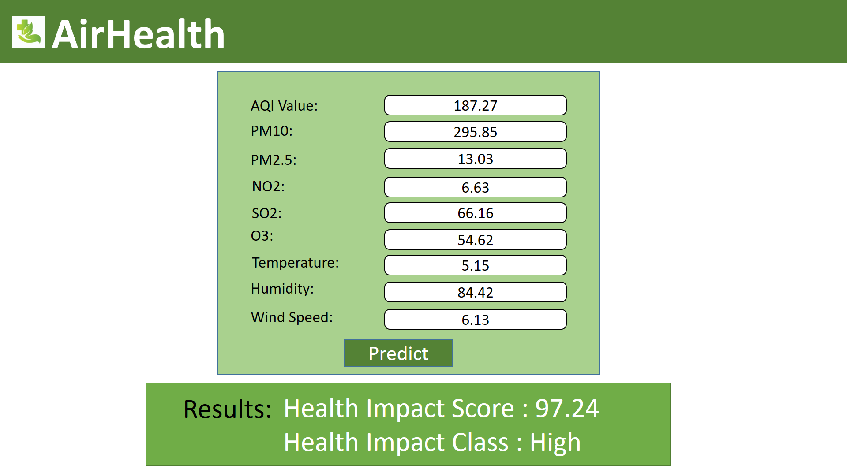
Excepted Results

Slide 17
References :
Moderate Air Quality Prediction Model Using Regression. (n.d.). [online] International Journal of Scientific Research & Engineering Trends. Available at: https://ijsret.com/wp-content/uploads/2024/03/IJSRET_V10_issue2_140.pdf.
‌Mohammed, A., S. Roshan Zameer, Chowdhry, U. and Dr. Ashok Kumar (2024). Machine Learning-Based System for Weather Prediction and Air Quality Index Estimation. International Journal of Engineering and Management Research, [online] 14(2), pp.134–142. doi:https://doi.org/10.5281/zenodo.11084950.
Bohumír Garlík and Přívětivý, J. (2024). Artificial Intelligence Algorithms for Prediction and Diagnosis of Air Pollution Affecting Human Health. Journal of Physics Conference Series, 2701(1), pp.012072–012072. doi:https://doi.org/10.1088/1742-6596/2701/1/012072
Rahman, Md.M., Nayeem, Md.E.H., Ahmed, Md.S., Tanha, K.A., Sakib, Md.S.A., Uddin, K.M.M. and Babu, H.Md.H. (2024). AirNet: predictive machine learning model for air quality forecasting using web interface. Environmental Systems Research, 13(1). doi:https://doi.org/10.1186/s40068-024-00378-z.

Slide 18


